Slide 1

HIPAA
Health Insurance Portability & Accountability Act
PRIVACY RULE
SECURITY RULE
Breach Notification
Enforcement Rule

Slide 2
WHAT IS HIPAA?
HIPAA is a U.S. federal law that protects patients’ private health information.
Any organization that handles medical records, insurance information, or health‑related data must follow HIPAA or face significant penalties.
The 4 HIPAA RULES
Privacy Rule Controls who can view and use patient information
Security Rule Requires administrative, physical, and technical safeguards for electronic records
Breach Notification Rule Requires notifying patients within 60 days after a breach
Enforcement Rule Establishes fines up to $1.9M per violation category per year
WHO MUST COMPLY?
Hospitals & Clinics | Pharmacies
Dental Offices | Health Insurers
Healthcare IT Vendors | Labs & Testing Centers

Slide 3

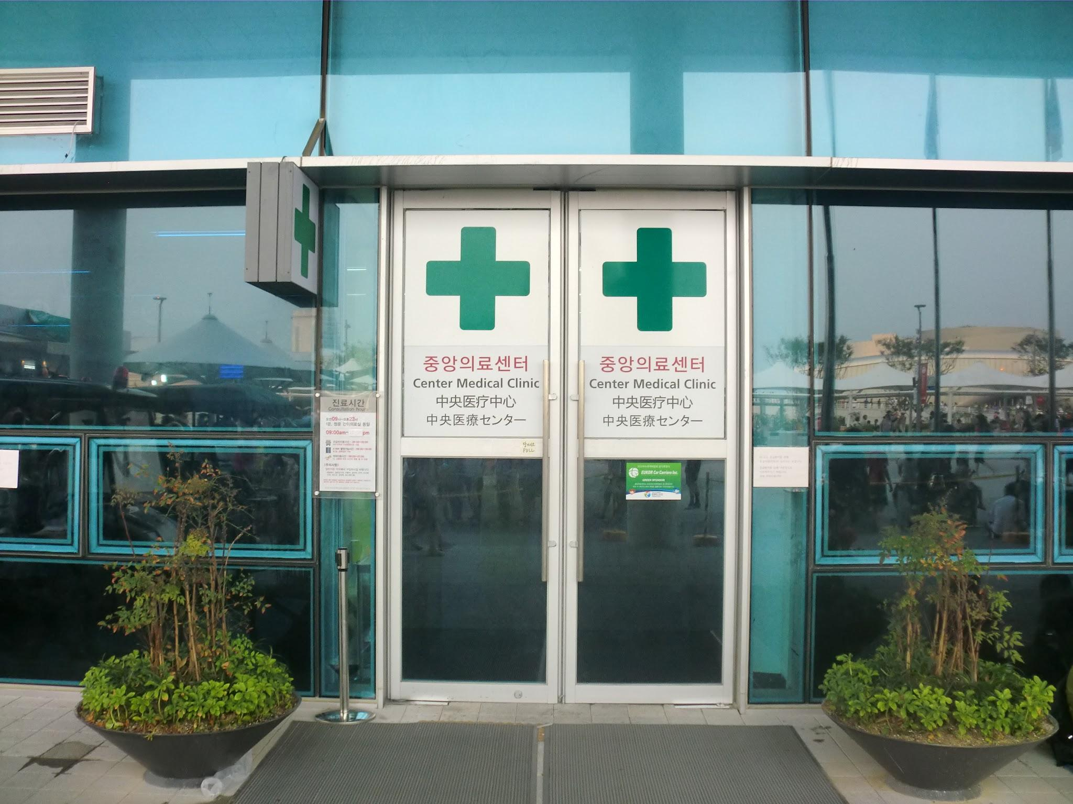
PROJECT SCENARIO – BLUE STAR MEDICAL CLINIC
You are a cybersecurity analyst hired by Blue Star Medical Clinic. They store 1,200 patient health records digitally. Your job is to evaluate HIPAA compliance and build a remediation plan.

Slide 4

What the Clinic Has
Electronic Health Record (EHR) software
Cloud storage for patient files (Google Drive)
50 employees with access to various systems
Basic username/password logins
Paper sign‑in sheets at reception
No formal security policies
HIPAA Gaps Identified
No Multifactor Authentication (MFA)
Patient data not encrypted at rest
No formal HIPAA training for employees
Missing Business Associate Agreements (BAAs)
No documented incident-response plan
Audit logs not being reviewed

Slide 5
HIPAA PRIVACY RULE
CONTROLS WHO CAN ACCESS AND USE PROTECTED HEALTH INFORMATION (PHI)
WHAT IS PHI? - Protected health information is any information that can identify a patient named date of birth diagnosis insurance ID address phone number photos or any combination of these.
Minimum Necessary Rule
Share the minimum info details
Receptionist doesn't need diagnosis details
Billing only sees payment info
Apply to all staff and vendors
Patient Rights
Patience can request their own records
Patients can request corrections
Patience can restrict who sees their info
Must respond within 30 days
Permitted disclosures
Can share with treating providers
Can share for billing purposes
Can share for public health reporting
Never share for marketing without consent

Slide 6
HIPAA Privacy Rule
REQUIRES 3 TYPES OF SAFEGUARDS TO PROTECT ELECTRONIC (ePHI)
WHAT IS PHI? - Protected health information is any information that can identify a patient named , date of birth diagnosis insurance ID address phone number photos or any combination of these.
ADMINISTRATIVE SAFEGUARDS
RISK ANALYSIS Conduct a written risk assessment identify every threat to ePHI.
WORKFORCE TRAINING Train ALL employees on HIPAA annually, Document it.
ACCESS MANAGEMENT Formal process for granting and revoking system access.
CONTINGENCY PLAN Written for data backup and disaster recovery
PHYSICAL SAFEGUARDS
FACILITY ACCESS CONTROLS Locked server rooms, keycards access, visitor logs.
WORKSTATION SECURITY Screen locks, privacy screen, no unattended sessions.
DEVICE CONTROLS POlicy for laptops, USB drives, and mobile.
DISPOSAL POLICY Shred paper records, wipe drives before disposing of hardware.
TECHNICAL SAFEGUARDS
ACCESS CONTROLS Unique user IDs, MFA, auto-logoff after after 15 min idle.
AUDIT CONTROLS Log all access to patient records who, when, what.
ENCRYPTION Encrypt ePHI at rest (AES-256) and in transit (TLS 1.2+)
INTEGRITY CONTROLS Verify data hasn't altered use checksum/hashing.

Slide 7





HIPAA BREACH NOTIFICATION RULE
Scenario: The ransom attack encrypted 800 patient records here exactly what HIPAA requires.
PATIENTS
WITHIN 60 DAYS Send written notification by first class mail or email if they opt in must include what happened what PHI was involved what you're doing about it and a toll free number to call.
WITHIN 60 DAYS If 500 or more residents of a single state are affected notify a major media outlet in the state (e.g. Local TV news station or newspaper)
WITHIN 60 DAYS Submit a bridge report to the HHS office for civil rights at HHS.gov breach of 500+ must be reported immediately. Under 500 can be logged in reported annually.
WITHIN 60 DAYS If a vendor causes the breach they must notify you within 60 days your Business Associate Agreement (BAA) should require this. Without a BAA you are still liable.
MEDIA (If 500 = in a state)
HHS/Federal Gov.
Business Associates
Criminal penalties: Intentional misuse of PHI = up to 10 years in federal prison + $250,000

Slide 8
HIPAA ENFORCEMENT & PENALTIES
FINES AND PENALTIES
TIER 1
TIER 2
TIER 3
TIER 4
DON’T KNOW $100 - $50,000 PER VIOLATION MAX $25,000/year You violated HIPAA but had no way of knowing still a fine ignorance doesn't protect you.
WILLFUL NEGLECT (NOT FIXED) $50,000+ PER VIOLATION MAX $1.9M You knew violet intentionally and did not correct it maximum penalties apply.
REASONABLE CAUSE $1,000-$50,000 PER VIOLATION MAX $1000,000/year You should have known about the violation but weren't being deliberately negligent.
WILLFUL NEGLECT (FIXED) PER VIOLATION MAX $250,000/year You knew you were violating HIPAA and fix it within 30 days of discovery.

Slide 9
HIPAA COMPLIANCE CHECKLIST - ELITE STAR MEDICAL CLINIC
Conduct a formal written Risk Analysis SECURITY RULE
Encrypt all e PHi at rest (AES-256) and transit (TLS 1.2+) SECURITY RULE
Train all 50 employee on HIPAA - Document completion ADMIN SAFEGUARD
Create and test a data Backup & Recovery Plan ADMIN SAFEGUARD
Lock server room with keycard access and visitor log PHYSICAL SAFEGUARD
Enable MFA on all staff and admin accounts. SECURITY RULE
Sign business associate agreements (BAAs) with all vendors PRIVACY RULE
Implement audit logging on all systems that access PHI SECURITY RULE
Post a Notice of Privacy Practices (NPP) in the clinic PRIVACY RULE
Set workstations to auto-lock after 15 minutes idle TECHNICAL SAFEGUARD

Slide 10
PROJECT SUMMARY
HIPAA
PRIVACY RULE Define PHI, minimum necessary access, patient rights. | SECURITY RULE Applied all 3 safeguards: Administrative, Physical & Technical. | BREACH NOTIFICATION Built a 4-party notification plan with 60-day deadlines.
ENFORCEMENT Document fine tiers from $100 to $1.9M per violation. | COMPLIANCE CHECKLIST Create a 10-item remediation checklist for the clinic. | RISK ANALYSIS Identified 6 critical HIPAA gaps in the organization.

